Slide 1
IBM University Engagement Project Submission
“Exploring the Power of Agentic AI with IBM Granite and IBM Bob”

Slide 2

Project Tile – [online vs store shopping ]
Domain of Project – [ MARKETING ]
Student Name | Recent Passport Photo | Email ID | Mobile number [WhatsApp]
Recommended font style and size:
Font Style: Arial
Font Size (Heading): 28
Font Size (Content): 20

Slide 3
Problem Statement - online vs store shopping
Problem Statement
The retail industry is undergoing a significant transformation as consumers increasingly shift between online and physical store shopping. Businesses struggle to understand why a customer chooses one channel over another — is it their age, income, tech-savviness, or sensitivity to delivery fees? Without a data-driven model to predict individual shopping preferences, retailers must rely on broad demographic assumptions, leading to poorly targeted marketing campaigns, suboptimal inventory allocation, and missed revenue opportunities. The challenge is to build an intelligent system that can accurately classify a customer's shopping preference — Online, In-Store, or Hybrid — using their behavioural, demographic, and attitudinal attributes.
To address this, a machine learning classification model must be trained on the Online vs Store Shopping Dataset (~11,789 customer records, 24 features) covering variables such as monthly income, daily internet hours, tech-savvy score, online payment trust, need-to-touch-feel score, and city tier. The model must automatically preprocess mixed feature types, compare multiple algorithms (Logistic Regression, Random Forest, Gradient Boosting) via cross-validation, select the best performer, and expose its predictions through an interactive Streamlit web application — enabling any business user to enter a customer profile and instantly receive a shopping preference prediction along with class-wise probability scores, without any programming knowledge required.

Slide 4
PROPOSED SOLUTION
The proposed solution is an intelligent Online vs. Store Shopping Preference Prediction System that uses machine learning to classify customers into three categories: Online, In-Store, or Hybrid. The system analyzes demographic, behavioral, and attitudinal attributes, including shopping habits, payment preferences, convenience, and delivery expectations, to identify customer preferences.
A trained machine learning model processes the input data and predicts the most likely shopping channel, displaying prediction probabilities through a user-friendly Streamlit interface. These insights help retailers understand customer behavior, design targeted marketing campaigns, improve inventory allocation, and enhance customer engagement.
Furthermore, the system can be extended with Agentic AI to interpret predictions, generate personalized recommendations, and support data-driven business decisions. By incorporating customer feedback and monitoring model performance, future versions can adapt to changing shopping patterns.
The solution aims to transform customer data into actionable insights, enabling retailers to optimize marketing strategies, improve shopping experiences, and make informed decisions across online and physical retail channels.

Slide 5
Technology Used
Machine-learning methodology
Problem type: Supervised learning — multiclass classification.
Input: 24 customer demographic and behavioural features.
Target variable: Shopping preference — Online, Store or Hybrid.
Preprocessing: Numerical scaling and categorical encoding.
Prediction: pipeline.predict(input_df).
Probability estimation: pipeline.predict_proba(input_df).
Model evaluation: Test accuracy and, according to the sidebar description, five-fold cross-validation during model selection.

Slide 6
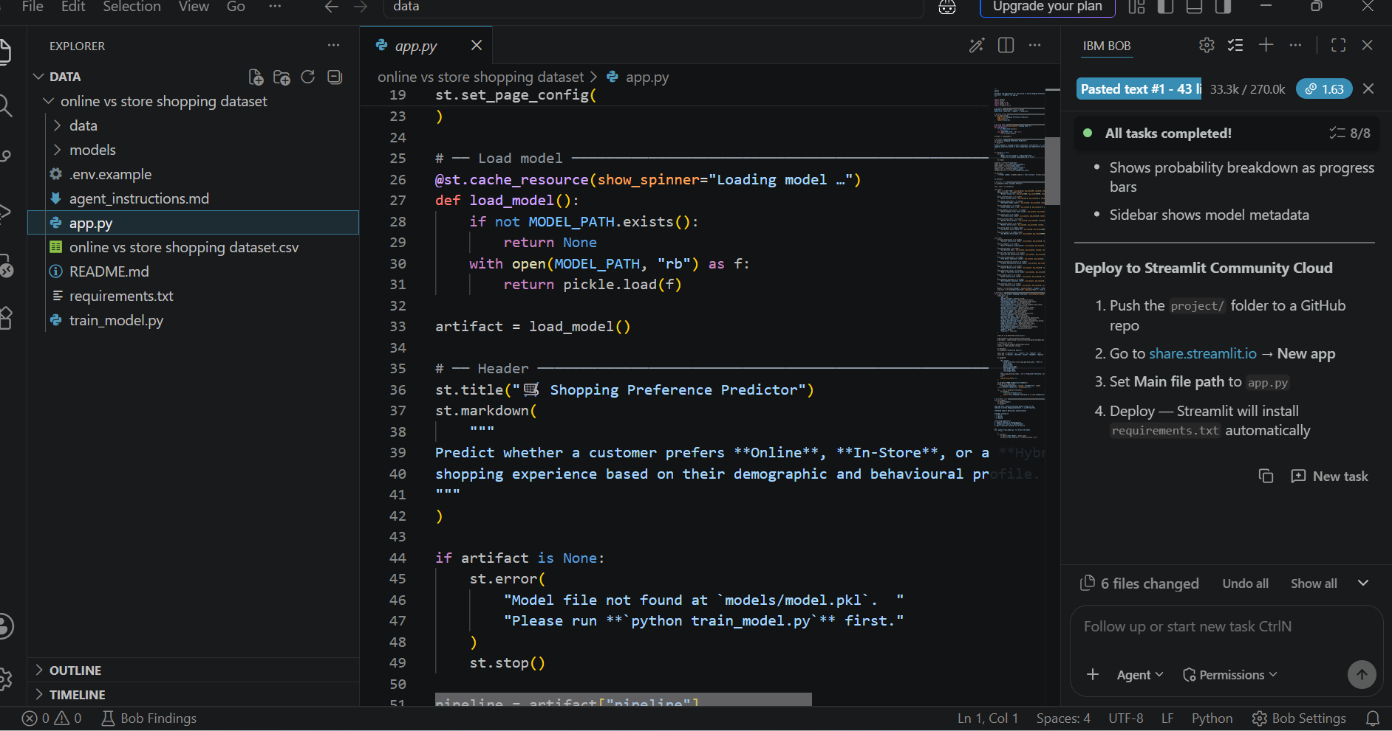
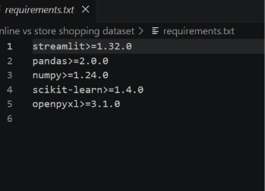
Required Files created using IBM bob -

Slide 7
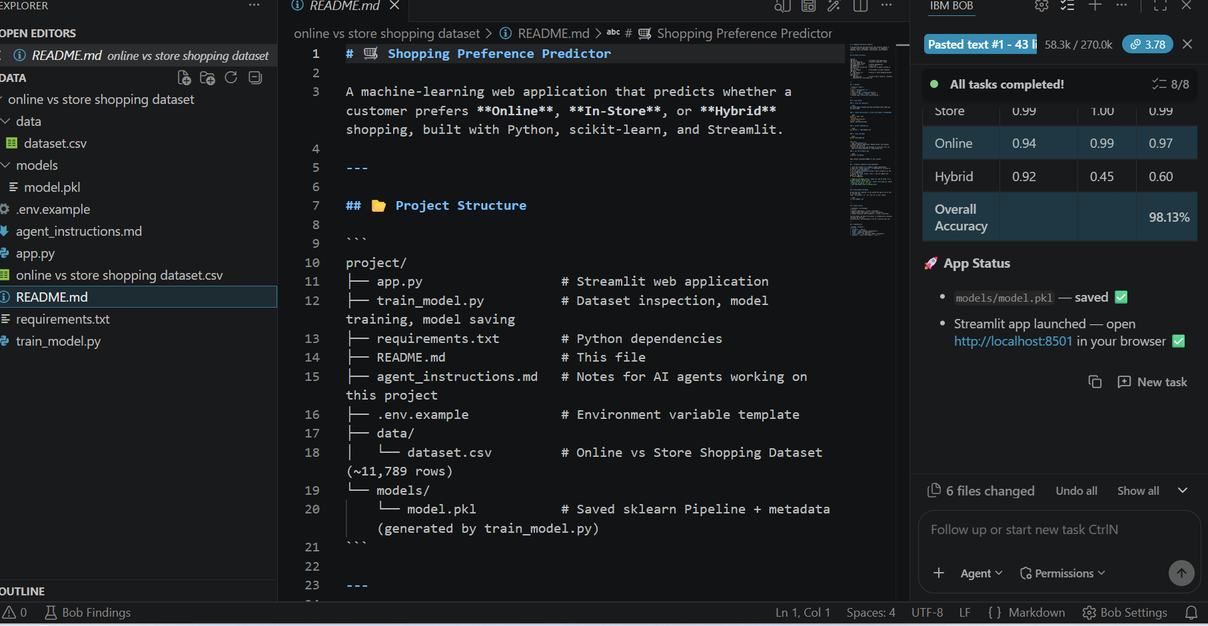
IBM Bob Screenshots:

Slide 8
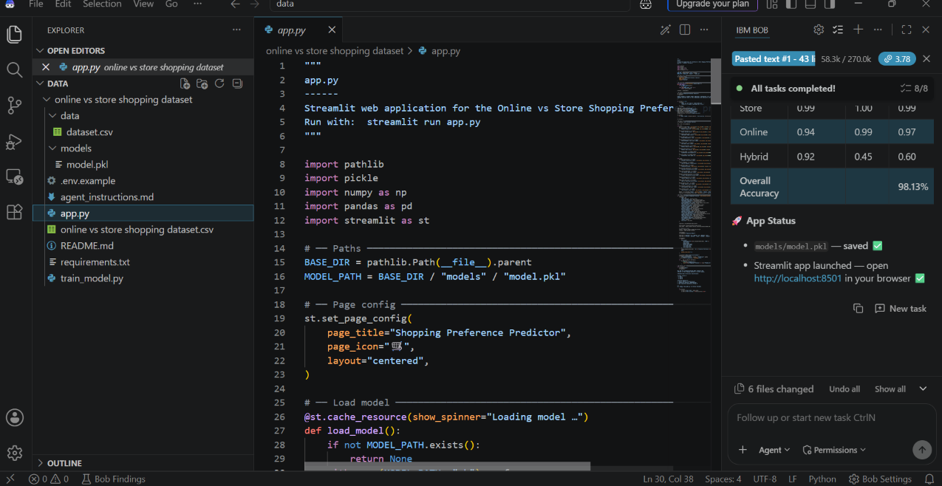

Slide 9
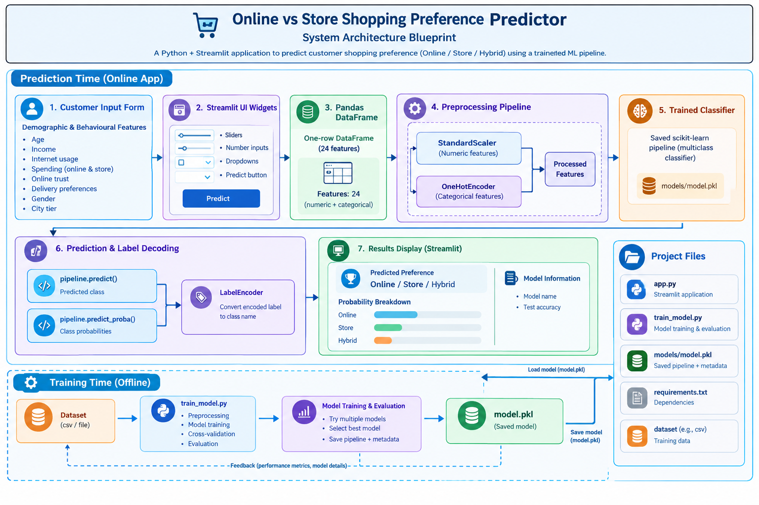
Architecture blueprint for IBM bob:

Slide 10
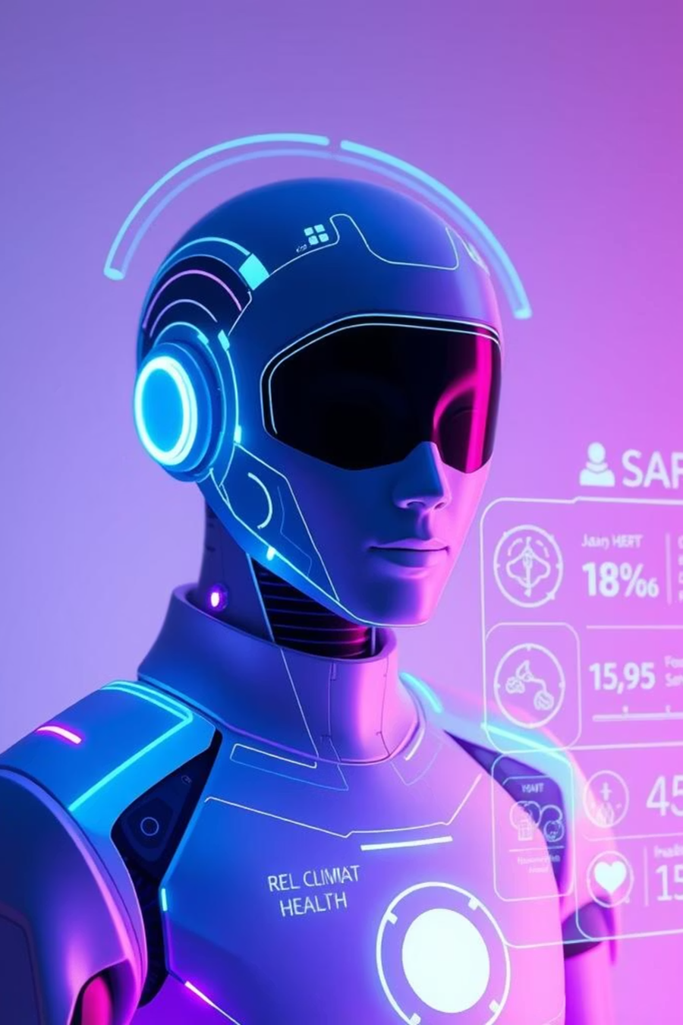
Role of Agentic AI in the solution
Role of Agentic AI in the Online vs. Store Shopping Preference Prediction System
Agentic AI enhances the proposed shopping preference prediction system by transforming machine learning predictions into intelligent, personalized business recommendations. While the existing machine learning model predicts whether a customer prefers online, in-store, or hybrid shopping, Agentic AI interprets the results and helps determine appropriate business actions.
Key Roles of Agentic AI
1. Customer Data Analysis: Examines customer characteristics, shopping habits, payment preferences, and other input features to identify relevant shopping patterns.
2. Prediction Interpretation: Interprets the machine learning model’s output and probability scores to explain the customer’s likely shopping preference.
3. Intelligent Recommendations: Suggests personalized strategies based on predicted preferences. For example, online-oriented customers may receive app-based offers, while store-oriented customers may benefit from in-store demonstrations and local promotions.
4. Confidence Assessment: Identifies uncertain predictions and recommends further evaluation instead of relying on potentially unreliable results.
5. Business Decision Support: Helps marketing managers select suitable promotional strategies, improve customer engagement, and allocate resources across online and physical retail channels.
6. Feedback and Continuous Improvement: Monitors customer responses and recommendation outcomes. With appropriate feedback data and controlled retraining, the system can support future model improvements.
Integration with Existing Technologies
The existing application uses Python, Streamlit, Pandas, NumPy, scikit-learn, and a trained model stored as model.pkl. Agentic AI can be added through a large language model (LLM), an agent orchestration framework, and suitable data connections.

Slide 11
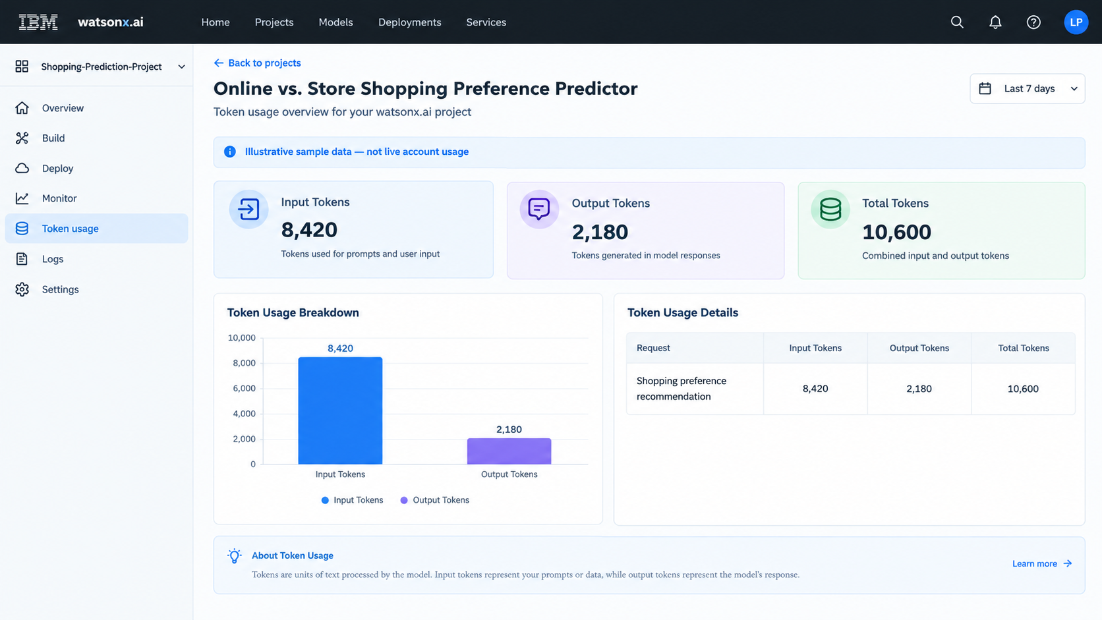
Token Usage
·
·
·

Slide 12
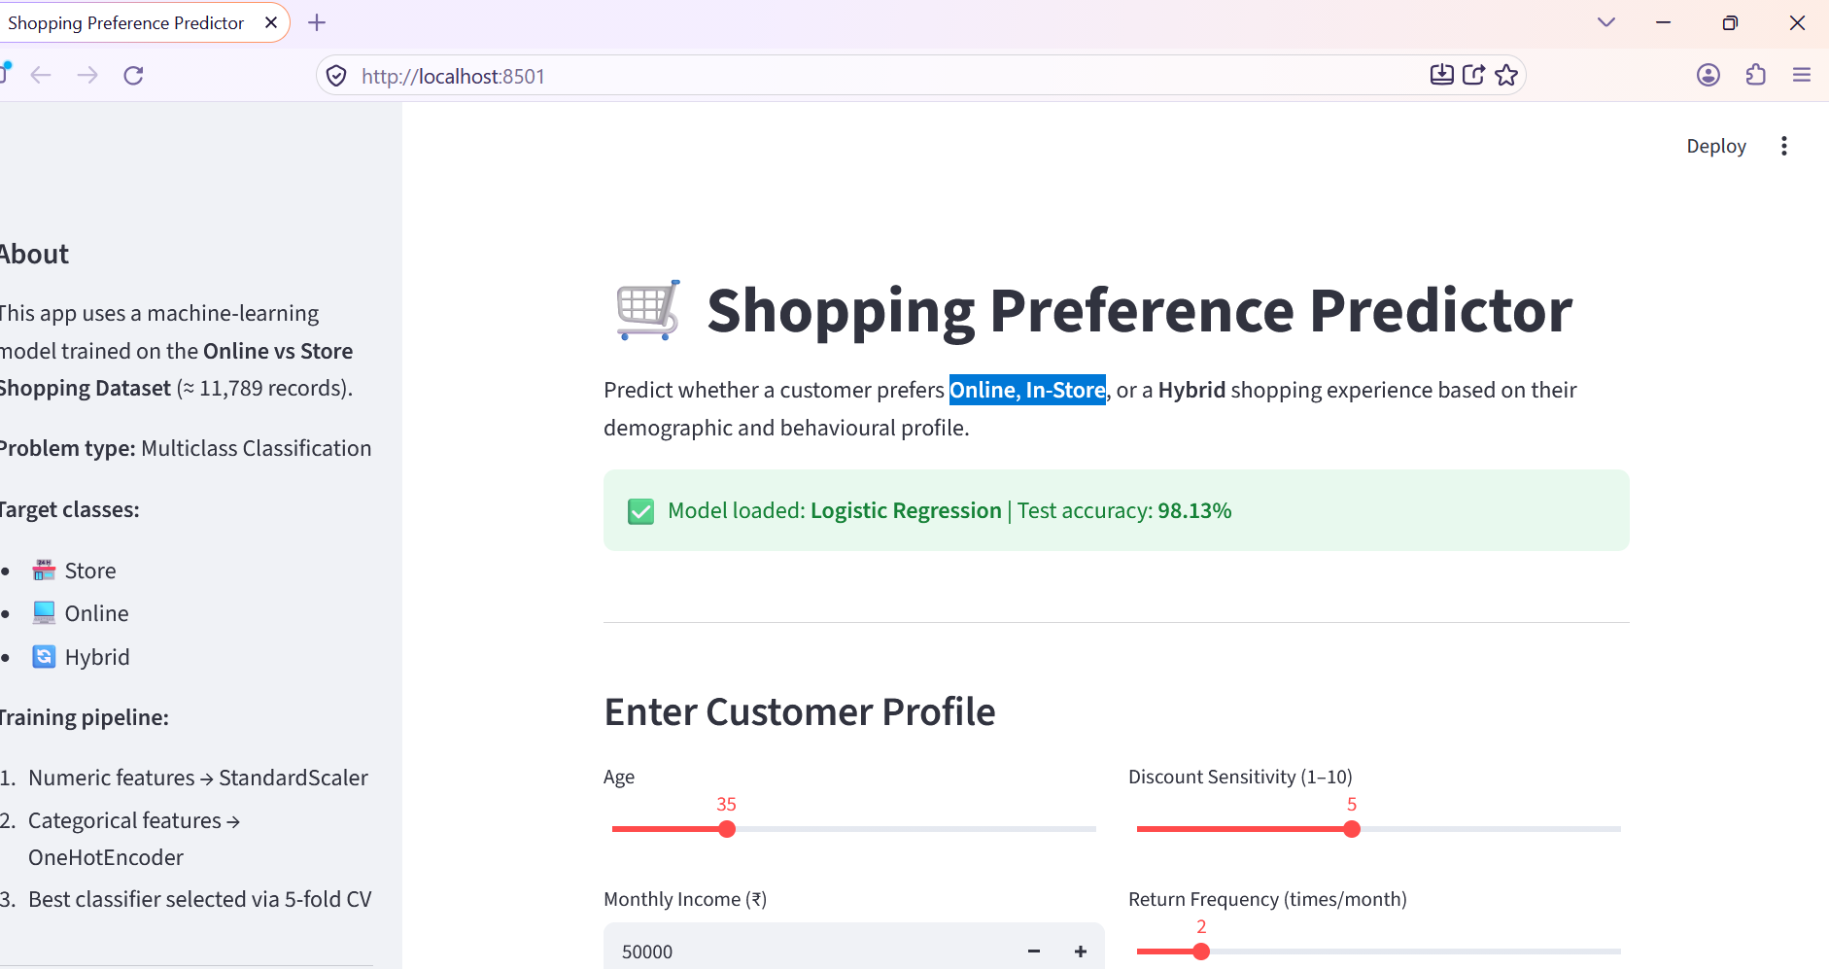
Project Output Screenshot
·
·
·

Slide 13
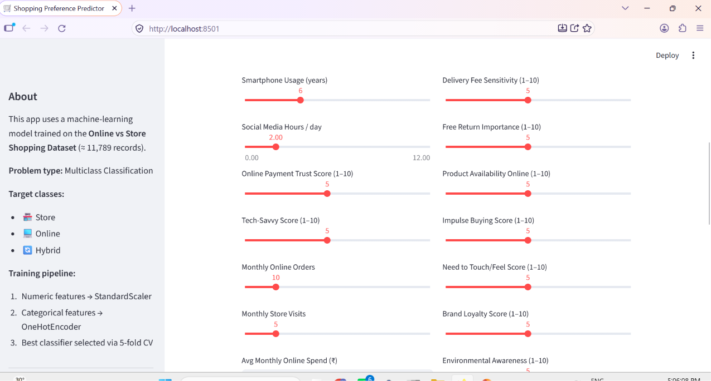
Project Output Screenshot
·
·
·

Slide 14
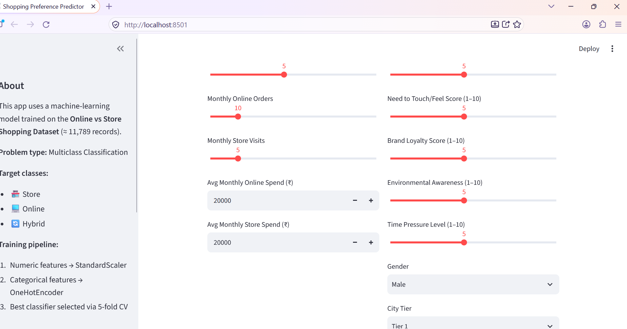
Project Output Screenshot
·
·
·

Slide 15
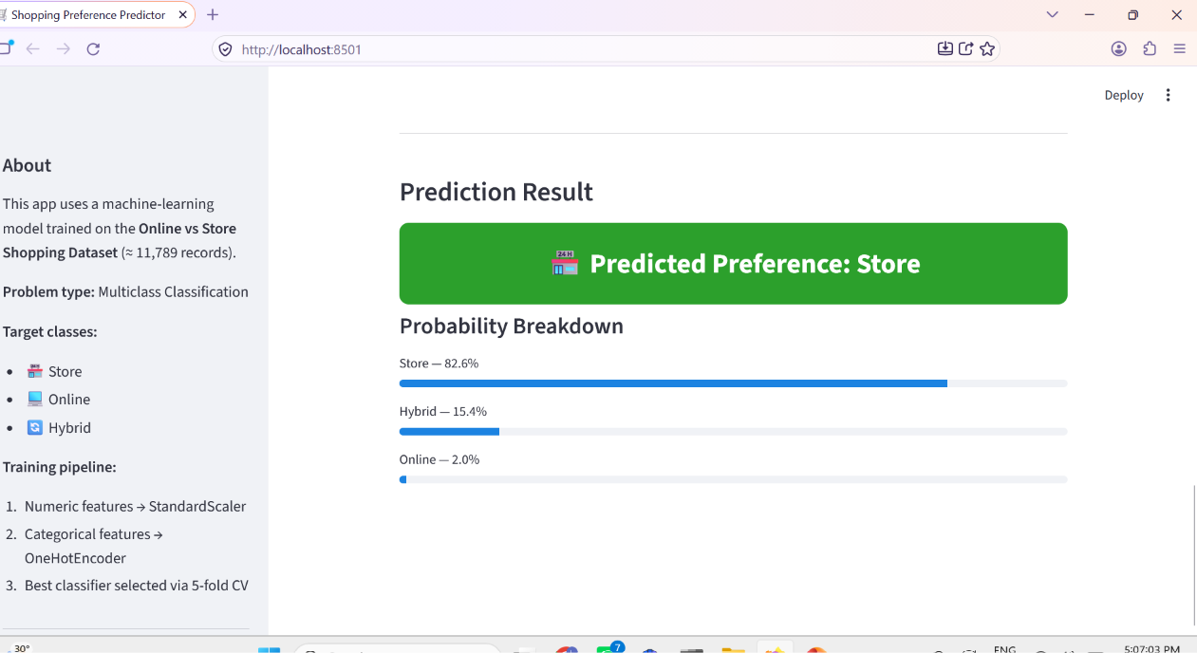

Slide 16
FUTURE SCOPE
The proposed Online vs. Store Shopping Preference Prediction System offers significant opportunities for future development through advanced technologies, intelligent automation, and personalized retail solutions.
Agentic AI Integration – Future versions can incorporate Agentic AI to interpret predictions, generate personalized recommendations, and support marketing decisions through intelligent, goal-oriented workflows.
Real-Time Preference Prediction – Integrating live browsing behavior, purchase history, transaction records, and customer interactions can help identify changing shopping preferences and improve prediction accuracy.
Advanced Personalization – The system can recommend customized discounts, product suggestions, delivery options, and in-store experiences according to individual customer preferences and shopping patterns.

Slide 17
FUTURE SCOPE
Omnichannel Integration – Connecting e-commerce websites, physical stores, mobile applications, and customer relationship management systems can provide a unified understanding of customer behavior across shopping channels.
Explainable Artificial Intelligence – Explainable AI techniques can identify the factors influencing predictions, helping businesses understand customer preferences and make informed decisions.
Sentiment and Behavioral Analysis – Customer reviews, feedback, and social media sentiment can be analyzed to understand shopping motivations, satisfaction levels, and emerging consumer trends.
Continuous Model Improvement – Collecting verified customer feedback and actual purchase outcomes can support regular model evaluation, performance monitoring, and controlled retraining.
Scalable Cloud Deployment – Integration with platforms such as IBM watsonx.ai can support scalable deployment, advanced AI capabilities, governance, and monitoring.
Privacy and Responsible AI – Future development should prioritize customer consent, data security, fairness, and responsible use of personal information.

Slide 18
Novelty and Uniqueness
The proposed Online vs. Store Shopping Preference Prediction System stands out by combining Machine Learning, Agentic AI, and personalized retail recommendations into an intelligent decision-support solution.
Predictive Intelligence – Uses machine learning to predict whether customers prefer online shopping, in-store shopping, or a hybrid approach based on customer characteristics and shopping behavior.
Agentic AI Integration – Extends prediction beyond classification by interpreting results, planning suitable actions, and generating context-aware business recommendations.
Personalized Shopping Strategies – Suggests targeted approaches, such as online discounts, home delivery benefits, in-store demonstrations, or omnichannel offers, based on predicted preferences.
Confidence-Based Decisions – Uses prediction probabilities to identify uncertain results and avoid overconfident recommendations.
Omnichannel Retail Focus – Helps businesses understand customer preferences across digital and physical shopping channels, supporting better channel planning and customer engagement.
Feedback-Driven Improvement – Incorporates customer responses and actual shopping outcomes to evaluate recommendations and support controlled model improvement.
Business-Oriented Analytics – Converts customer data into actionable insights that can support marketing campaigns, customer relationship management, and resource allocation.
Scalable and Governance-Ready – Can be extended using IBM watsonx.ai and IBM Granite models, with appropriate privacy safeguards, monitoring, and human oversight.
This makes the solution a predictive, adaptive, and action-oriented retail intelligence system, rather than merely a shopping preference classification model.

Slide 19
Git Hub Link
· Please create public github repository (Enable Add README button while creating repository) with format –
Please test and Paste the working Github URL –
Make sure you have Uploaded following three files into your github repository
1) All Agent relevant files of IBM Cloud , 2) yourproblemstatement.pdf file 3) your projectpresntation.pptx file 4)any other files
·
·
·

